Slide 1
Extending Working Lives in the UK: Why don’t we see more variation?
Sarah Vickerstaff @EWLives
Sue Shepherd @sueshepherdHE
Mariska van der Horst @MariskavdHorst
Funded through Uncertain Futures: Managing Late Career Transitions and Extended Working Life project by the ESRC, ESRC reference: ES/L002949/1

Slide 2
Tony Bennett – I left my heart in San Francisco
Most recent album in 2016, celebrating 90th birthday
Quoted to say: “I’ll never retire”
Photo tom.beetz: CC BY 2.0 https://www.flickr.com/photos/9967007@N07/6582221985
Notes:
Photo from: https://www.flickr.com/photos/9967007@N07/6582221985
Quotes: https://www.brainyquote.com/quotes/quotes/t/tonybennet747166.html
Tony Bennett extended working life…
Started career in 1950 (first demo), most recent album 2015/2016 – his music career spans more than 65 years?

Slide 3
Extending Working Lives
Policies to stimulate working up to / beyond State Pension Age
Talk about “new transitions”, such as un-retirement, phased retirement, move into self-employment, etc.
This presentation: evidence from quantitative and qualitative research
Notes:
We will show in this presentation about

Slide 4
Quantitative research
English Longitudinal Study of Ageing (ELSA), waves 1-6
Respondents aged 50-60 in first wave who participated in all six waves
2,286 respondents
Sequence analysis followed by cluster analysis
Mostly see single exit from labour market
Little evidence for “new transitions”

Slide 5
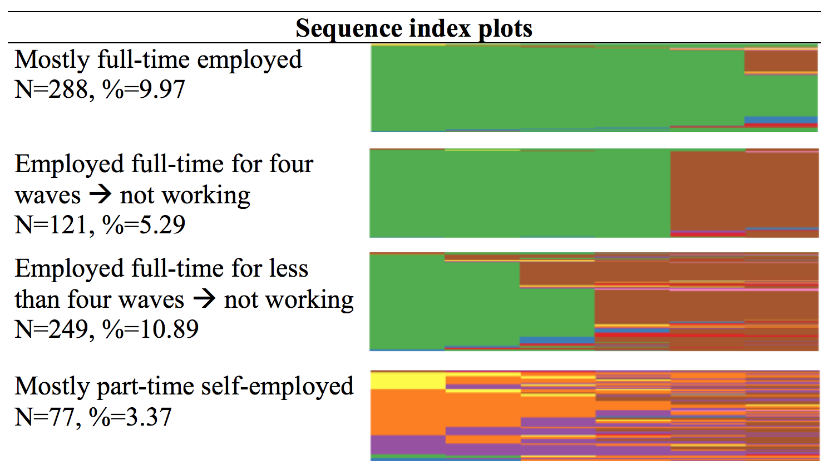

Slide 6
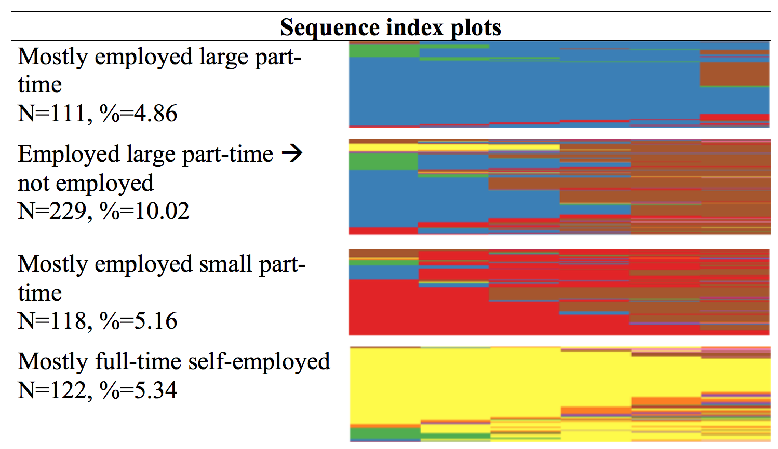

Slide 7
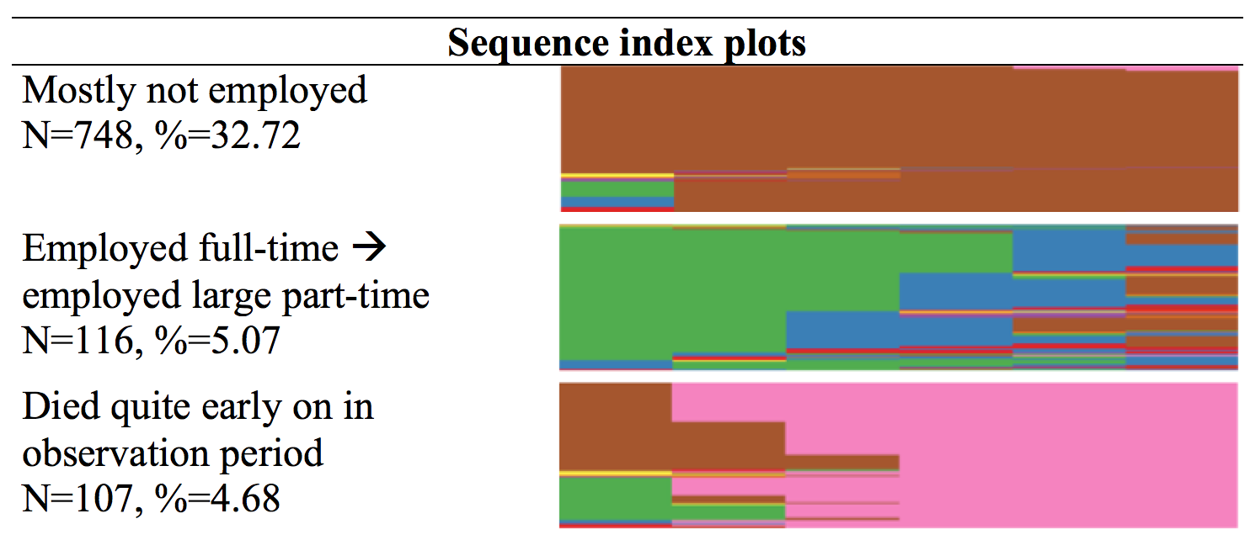

Slide 8
Qualitative research
Qualitative data complements and supplements the quantitative analysis
Data is more recent (2015/16) giving a contemporary snapshot of employees’ retirement thinking following the abolition of a mandatory retirement and the equalisation of state pension ages
Provides additional insight on what is happening inside organisations
Examines intended – as opposed to actual – retirement transitions
In some cases, individuals may be very uncertain about their future plans and more than one option may be under consideration
These findings reflect a judgement about an employee’s primary intended transition, according to following typology:

Slide 9
Transition typology
Transition type | Definition
Full Retirement | Cliff edge retirement from current organisation with no subsequent paid employment plans. This can be early (before 65) or on time (at 65)
Extended Working | Continued employment in the current organisation in the same role and same hours beyond the age of 65 with no subsequent paid employment plans. This is a form of late full retirement
Phased Retirement | Continued employment in current organisation with a reduction in hours or grade. This may be by means of a formal flexible retirement scheme (with pension drawdown) or individual negotiation
Partial Retirement | Bridge employment on reduced hours following retirement from current organisation. This may be via self-employment or paid employment in another organisation (and in either a career or non-career role)
Serial Retirement | Retirement from current organisation by an ‘unretired’ employee who has already retired with a pension from another paid job and re-entered employment
Encore Retirement | Retirement from the current organisation followed by unpaid employment

Slide 10
Participant profile
CASE STUDIES | Number of Participants | % Female | % Blue Collar | % Full Time | % Occupational Pension | Labour Turnover
Local Government (LG) | 37 | 54 | 13 | 92 | 78 | Major downsizing via VS/VER
Transport (TR) | 18 | 39 | 67 | 100 | 100 | Low
Hospitality (HO) | 22 | 64 | 54 | 73 | 86 | Low for the sector
Engineering & Manufacturing (MA) | 26 | 19 | 12 | 100 | 100 | Low

Slide 11
Transition intentions
Transition type | % Local Gov | % Transport | % Hospitality | % Eng & Man* | All
Full Retirement | 27 | 39 | 46 | 42 | 37
Extended Working | 43 | 44 | 41 | 12 | 35
Phased Retirement | 5 | 6 | 4 | 15 | 8
Partial Retirement | 22 |  |  | 27 | 15
Serial Retirement | 3 | 11 | 9 |  | 5
Encore Retirement
* Intended transition type is unknown for one of these participants

Slide 12
Key Findings (1)
Full, or cliff edge, retirement from current employer remains the norm (72%)
37% intend to fully retire early or on time (i.e. at the former MRA of 65)
35% – the extended workers – plan to work beyond 65 before full retirement
Finance is the main reason given for having to work longer, though many enjoy their job or wish to keep working due to a strong work ethic/identity
There is a striking gender difference in relation to extended working, with 47% of women compared to 25% of men intending to keep working in the same organisation and fully retire after 65
In many cases this is due to the increase in SPA to 66/67. Women are more reliant on SP since their occupational pension is often smaller due to a combination of part-time working, low wages and late entry into the scheme

Slide 13
Key findings (2)
Only 8% plan to reduce their hours or grade in a phased retirement
Although, when prompted, many more employees view this as attractive, few have actively investigated it. For many it is financially unrealistic and even for those who could afford it, it is seen as difficult to achieve in practice
Only one employee is on a formal phased retirement scheme (Local Gov)
15% of employees are planning partial retirement via bridge employment. These are untypical participants, i.e. Local Gov employees applying for VER and highly-skilled and marketable professionals in Manufacturing
Most employees are realistic about their chances of securing a sufficiently well-paid part-time job elsewhere in their 50s or 60s
There are five ‘unretired’ employees planning serial retirement and no one intending unpaid encore retirement

Slide 14
Conclusion
Both quantitative and qualitative data show limited evidence for phased retirement, partial retirement/bridge employment or unretirement
Job continuity, not change, is the main feature of later working life
Evidence in case studies of employees’ intention to extend working life - more true for women than men
Highlights ‘gender asymmetry’ due to relative financial disadvantage
Late retirement is usually only a bit longer (usually until SPA of 66/67) – not “Tony Bennett style”
Some constraints to late working:
Finance
Downshifting not practical or affordable
Poor knowledge of/access to flexible working opportunities

Slide 15
Policy implications
Greater ‘buy in’ to the idea that people need to work longer – or at least, less apparent resistance to it than formerly
Good news for policymakers wishing to release the untapped potential of older women in the workforce
But, policy assumption of greater flexibility in retirement (e.g. Cridland 2016) is not justified
To facilitate phased retirement employers need to offer not just flexible working, but a formal phased retirement option with pension drawdown facility
To increase partial retirement opportunities via bridge employment requires a supply of suitable part-time jobs that are accessible to older workers

Slide 16
Thank you!
Thanks to all the people involved with the project:
Ben Baumberg-Geiger, Amanda Burns, Charlotte Clark, Joanne Crawford, Amanda Fahy, David Lain, Wendy Loretto, Chris Phillipson, Mark Robinson, David Wainwright, Andrew Weyman

Slide 17
Questions?
Twitter:
Project: XtendingWorkingLives @EWLives
Own: Sue Shepherd @sueshepherdHE
Mariska vd Horst @MariskavdHorst
Website project:
http://www.kent.ac.uk/extendingworkinglives/index.html
Own:
http://sue-shepherd.co.uk/
http://mariskavanderhorst.com/

